Slide 1
ML1030 NLP Interpretability (Progress update)
Michael Vasiliou
Notes:
good morning and welcome to my ML 1030 progress update for my capstone project on NLP interpret ability

Slide 2


Project summary
Machine Learning model interpretability in a clinical setting
Natural Language Processing (NLP) interpretability
Notes:
The overall research project goal is to improve the ability and acceptance of Machine Learning in clinical decision making. The research project focuses on model interpretability across multiple models and datasets including the IMDB movie review, and the MIMIC 3 clinical dataset.
Through analyzing the disparate datasets, including the health care records and discharge summaries of 40,000 patients and comparing interpretability across multiple machine learning models, the project aims to improve clinician trust, model interpretability, and uptake within a clinical setting.
In something as important as healthcare it’s critical for the end users to understanding the reasons why a machine learning model is making it’s predictions.

Slide 3
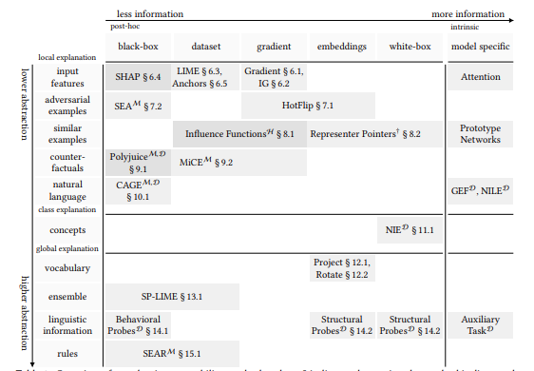
Model Interpretability
SHAP
LIME
Transformers-Interpret
Natural Indirect Effect (NIE)
<more>
Source: Post-hoc Interpretability for Neural NLP: A Survey by Madsen, Reddy, Chandar
Notes:
There are a number of interpretability options and the project team is looking to implement as many as possible beginning with SHAP, LIME, Transformers-interpret, and Natural Indirect Effect (NIE). Other interpretability options will be added in future iterations of the research project.

Slide 4
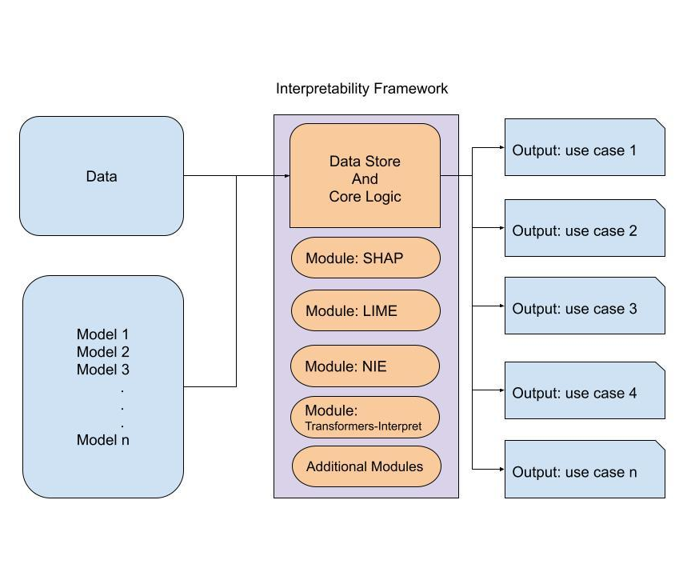
Interpretability Framework
Key Factors
Multiple models
Multiple data sets
Project longevity
Multiple interpretability frameworks
Multiple team members
Benefits:
Consistency
Repeatability
Ease of use
Longevity/Expansion
Notes:
My focus within this project is going to be to create interpretability framework that will be able to take the existing pre-cleaned data, multiple trained models, and begin implementing interpretability frameworks. This framework will use the implemented Interpretability options to examine and compare, global model interpretability results, and specific record interpretability between models.
The research project is a long term initiative that will extend beyond the length of this class. The implemented framework must be maintainable and expandable by the project team to ensure project continuity and future expandability of additional interpretability options.
To that end, knowledge transfer throughout this initiative will be critical to the projects success.

Slide 5


Notebook walkthrough

Slide 6

Alternatives
Considered mainstream options/components
High learning curve
Increased technical debt
Notes:
a number of mainstream options and components was considered including something like ML flow. While excellent products they come with a high learning curve for people to use and integrate and they also come with an increased technical debt for maintenance. A lightweight simple framework without complexity was determined to be the ideal starting point and it can be upgraded in the future if needed.

Slide 7
Next Steps
Integrate
Architect
Enhance
Additional use cases
Model comparability
Existing models
Train
Match project standardized format
CNN
Kmeans
Random Forest
Test
Val
QA
Knowledge Transfer
Notes:
With knowledge transfer as a key foundational component, the next steps in this project will be to integrate the existing trained models, architect the Data storage to match the standardized project format, and add as many interpretability options as possible to address the researchers needs and use cases.
There is insufficient time to include all the interpretability options. The goal is to lay the pipeline foundation with some interpretability options in order to allow the project team to enhance for continued future success.

Slide 8



